Slide 1
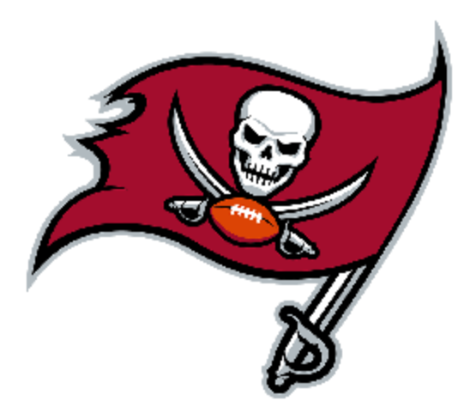
Tampa Bay Buccaneers
Sports Organization Project
PUR 3463
Josh Kapke
Dec 2020
Notes:
Hi I am Josh Kapke and my project is on the Tampa Bay Bucs

Slide 2
Bucs Stakeholder Groups and Examples
Athletes
  Tom Brady - quarterback
  Mike Evans - wide receiver
  Devin White - linebacker
  Chris Godwin - wide receiver
Team
  Glazer Family - Owners
  Jason Licht - General Manager
  Bruce Arians - Head Coach
  Byron Leftwich - Defensive Coordinator
  Todd Bowles - QB Coach
  Clyde Christiansen- Offensive Line Coach
  Nelson Luis- VP Communications
  Steve Fidura - Director Community Relations
  Jim Mackes, Director Events/Entertainment
  Ben Milson - Chief Ticketing Officer/Sales
  Joe Fada- CFO
Governing Bodies
  NFL
  Hillsborough County
Spectators
  Bucs Fans
  Tampa Bay community
  Rays Fans, Lightning Fans
Media
  WTSP Channel 10 local TV
  Bucs Radio Network 98Rock 97.9FM
  Tampa Bay Times newspaper
  Buccaneers.com and mobile app
Community
  Bucs Girls Flag Football, Bucs Foundation, Bucs Social Justice Initiative
Financial Stakeholders, Suppliers/Sponsors
  Owners, “Pewter Partners,” Sponsors
Notes:
Stakeholders are affected whenever the Bucs organization takes an action. They are affected when they win or lose, communicate, market or promote. For example, the athletes are affected through their paychecks, their prestige and fame, their future career and the statistics that they put up. They depend on the other stakeholders for their opportunity and success. The owners look at the team as a business and they want to make a profit. The coaches, general manager and team staff are also invested for their careers and livelihood. They care about how the team’s success can also affect them personally. In addition, there are other stakeholders like the governing bodies, spectators, media, and the community. They are all affected by the Bucs and their play. Some may have to adapt to what the Bucs do, like the media. The Bucs have to submit to the governing bodies like the NFL and the county. Lastly, the financial stakeholders want to get a return on their investment, such as the Bucs’ sponsors which include Bud Light, Coca-Cola, Domino’s and many others.

Slide 3
Bucs Communications Staffing
Communications Department
Nelson Luis VP
Chris King Senior Manager
Community Relations Department
Steve Fidura Director
Allen Barrett Senior Manager
Digital and Media Department
Christi Bedan VP
Jeff Ryan Director Broadcast Operations
Max Brodsky Digital Operations Manager
Joey Nelson Digital and Social Content Manager
Together these departments lead and direct the execution of the Bucs broadcast, digital operations, social media and production for both digital and game offerings as well as overall communications and relations with the Bucs community
Notes:
The Bucs media guide outlines the organization overall. The public relation and media relations staff are organized into three levels-chiefs and VPs, directors and staff. The Bucs divide the responsibilities into the 3 departments of communications, community relations and digital and media. Together they lead and direct the execution of the Bucs broadcast, digital operations, social media and production for both digital and game offerings as well as overall communications and relations with the Bucs community

Slide 4

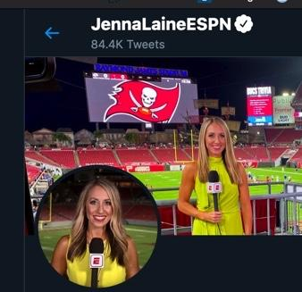

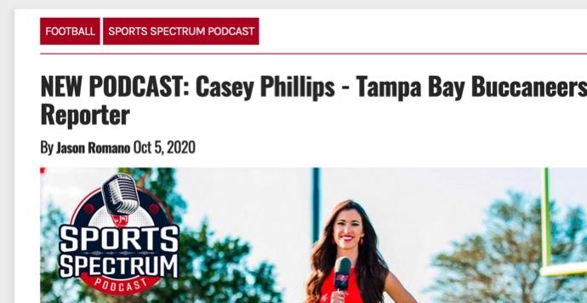
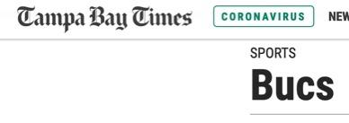
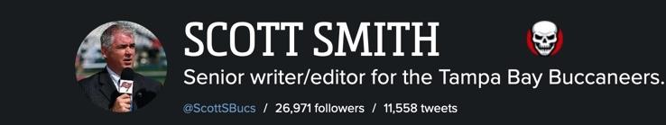
Influential Media Members
Buccaneers Radio Network 98ROCK 97.9FM
  Gene Deckerhoff play by play
  Dave Moore color analyst
  TJ Evans sideline reporter
WTSP Channel 10 TV
  Chris Myers play by play
  Ronde Barber color commentator
ESPN
  Jenna Laine reporter
Tampa Bay Times
  Mike Sherman deputy editor
Sports Spectrum Podcast
  Casey Phillips reporter
Sport Manias
  Scott Smith senior writer/editor
Notes:
The Bucs have several media outlets who cover them from the bucs radio network to podcasts, some of these have been around for years and do a terrific job with their coverage.

Slide 5
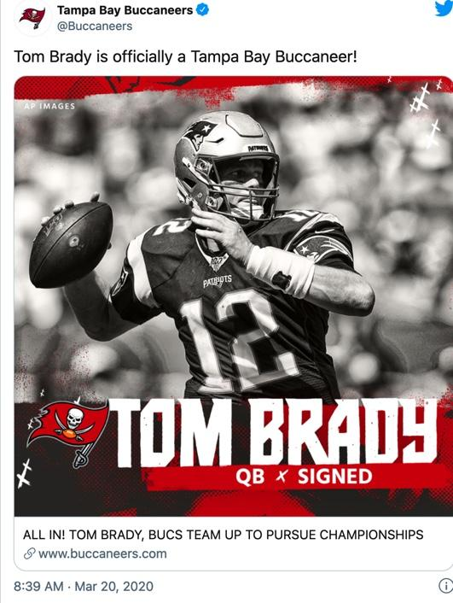
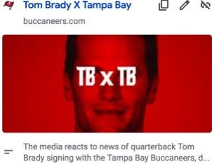
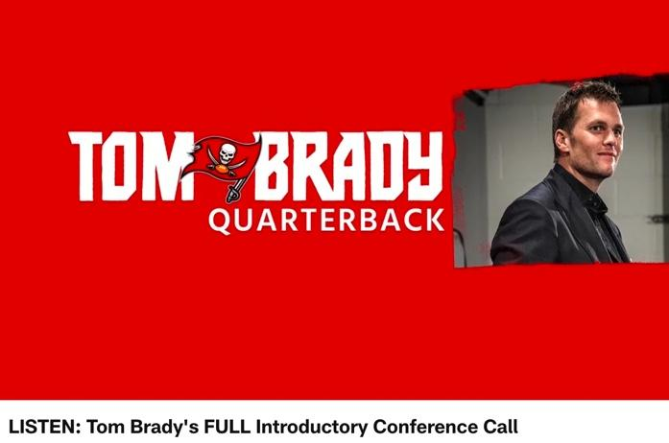
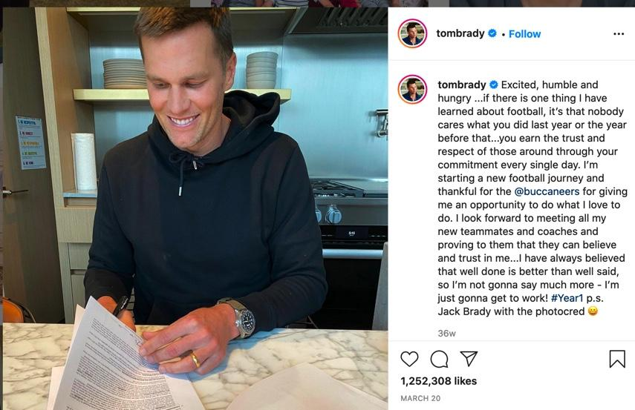
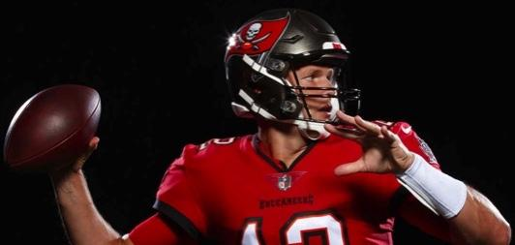
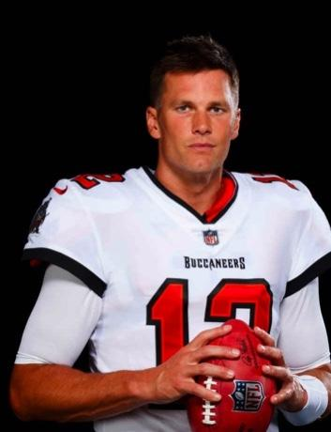
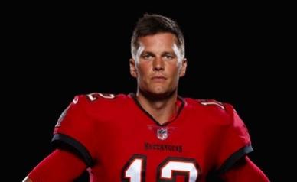
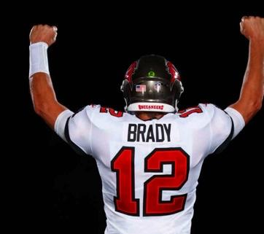
Summary of a PR campaign-
individual player Tom Brady
The GOAT is here. Tom Brady signs with the Bucs
Numerous articles flooded the media with the news based on Bucs press releases
  Links to example articles/press releases:
  https://www.buccaneers.com/media/press-releases
  https://www.buccaneers.com/news/tom-brady-qb-buccaneers-free-agency-roster-move
  https://touchdownwire.usatoday.com/2020/03/20/brady-buccaneers-make-it-official/
Press conferences held/video posted
  Example:https://www.buccaneers.com/video/tom-brady-breaking-news-tampa-bay-bucs-free-agency-2020
Conference Call recorded and shared
  Example:https://www.buccaneers.com/video/tom-brady-bucs-qb-conference-call-free-agency
Social media posts
  Bucs and Brady posted on Instagram
Photography session
  https://mattmayphotography.com/1843-tom-brady-for-the-tampa-bay-buccaneers/
Notes:
The Tampa Bay Bucs launched a huge PR campaign which was picked up by all major media outlets when they signed Tom Brady. They had photos taken with Tim in his new Bucs uniform, posted articles, held a press conference, recorded his first conference call with the team which was posted, and flooded social media with the purpose to hype the team and all the stakeholders on the promise of a new and exciting season for the Bucs now that they had what most consider the GOAT as their quarterback.

Slide 6
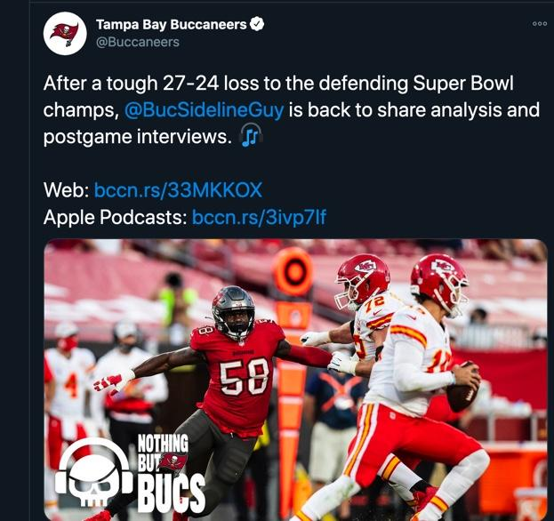
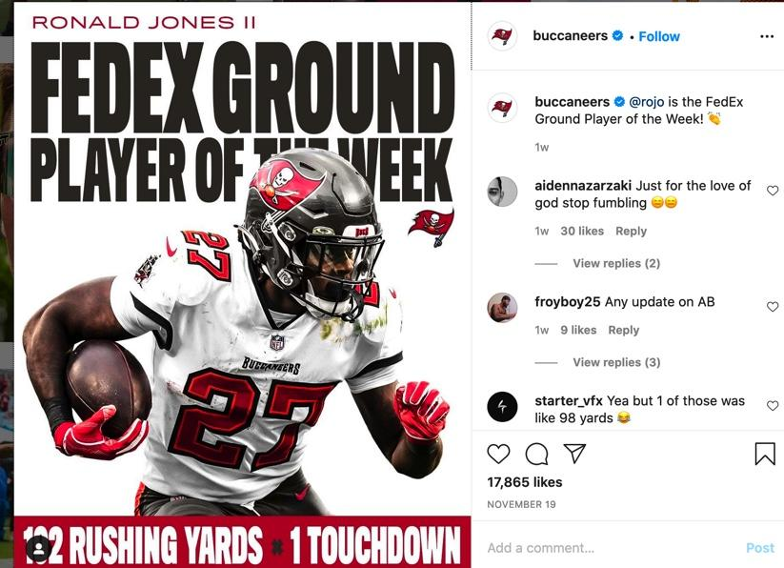
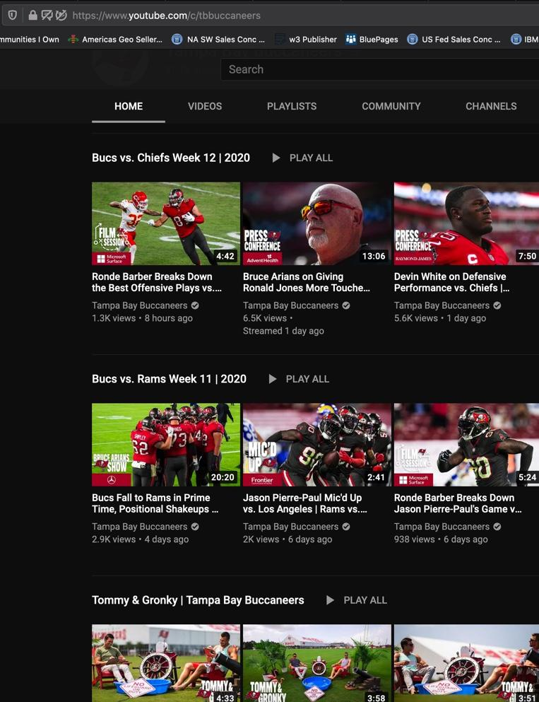
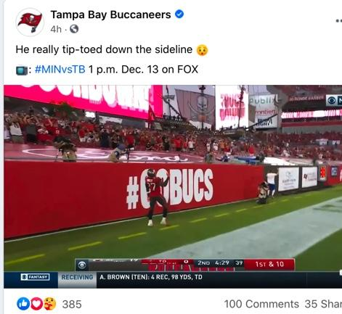
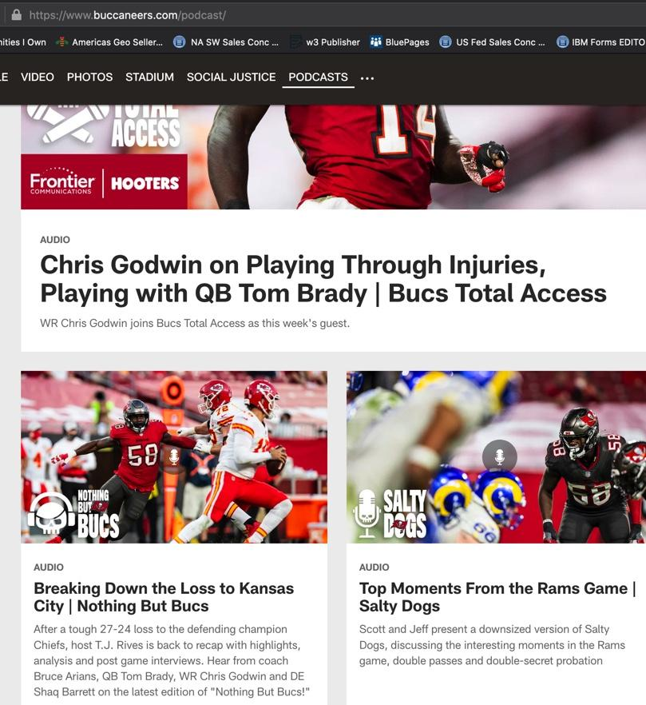
Effective Social Media Use Examples
The Bucs effectively use all social media platforms posting regular content including videos, photos, new stories. They include both team and individual player content
Twitter https://twitter.com/Buccaneers
Facebook https://www.facebook.com/tampabaybuccaneers
Instagram https://www.instagram.com/buccaneers/
YouTube
https://www.youtube.com/c/tbbuccaneers
Podcasts on demand
https://www.buccaneers.com/podcast/
Notes:
The Bucs are a dominant presence on Twitter, Facebook, Instagram and You Tube. They also utilize their Bucs app and website effectively. The Bucs effectively use all social media platforms posting regular content including videos, photos, and both team and individual player content. On Twitter and Instagram they have just short of 900,000 followers, and on Facebook just short of 1 million. Youtube has about 90,000 subscribers.

Slide 7
Examples of Positive/Negative Publicity
2018 -2020
Positive Publicity
Individual player Ryan Jensen
Ryan Jensen, Bucs center, recently reached out to a military family who recently lost their dad who was killed in action. In addition he has directly sponsored a community ticket program called “Jensen's G.I. Joes" to bring families to the Bucs’ stadium for a special game day experience. https://www.buccaneers.com/news/buccaneers-c-ryan-jensen-nominated-for-nfl-salute-to-service-award
Team - military related
The Bucs have also had a military day at training camp to further reach out directly to military families. In addition the Bucs have kept up their “Salute to Service” game which honors the military with special recognition and appreciation. This occurred at the Saints game November 8.
https://www.buccaneers.com/news/saints-bucs-salute-to-service-game-usaa-military-2020
Impact on organization
All of these initiatives generated positive publicity while enabling the Bucs to control the messaging.
Negative Publicity
Signing of Antonio Brown-Playoffs over Principle?
Several media outlets questioned the wisdom of signing Antonio Brown given his legal troubles, reputation and past behavior
https://www.tampabay.com/sports/bucs/2020/11/07/by-signing-antonio-brown-did-the-bucs-put-playoffs-over-principle/
https://www.theringer.com/2020/10/24/21531450/antonio-brown-bucs-tom-brady-nfl-reinstatement
https://www.si.com/nfl/2020/10/24/antonio-brown-signing-buccaneers-risk-long-term
Impact on organization
The impact of this story was minimal on the Bucs as most agree on Brown’s talent as a player and his controversy is well known.
Notes:
For the Bucs, the positive publicity has definitely outweighed the negative, especially since Tom Brady was signed. The Bucs do a lot in the community at both the team and player level to garner good publicity. On the negative front, the signing of Brown was controversial but the Bucs have had few, if any, players in a negative spotflight in recent years.

Slide 8
Examples of Media Coverage
Positive examples
Tampa signs the GOAT - Tom Brady
https://www.jacksonville.com/story/sports/nfl/2020/03/20/tom-brady-signs-with-tampa-bay-buccaneers/112251556/
Brady offensive player of the month
https://www.nbcboston.com/news/sports/nbcsports/tom-brady-wins-nfc-offensive-player-of-the-month-after-crazy-good-october/2220353/
Bucs bounce back after loss to Saints
https://www.nbcsports.com/video/tom-brady-buccaneers-bounce-back-nfl-week-10-win-vs-panthers
Negative examples
“Total team collapse” vs Saints
https://www.tampabay.com/sports/bucs/2020/11/08/tom-brady-throws-three-interceptions-in-38-3-loss-to-saints/
“Season slipping away?” Tampa Bay lost last 3 of 4 games
https://www.yahoo.com/now/sean-slipping-away-buccaneers-tom-brady-lose-another-one-as-chiefs-jump-on-them-early-002936015.html
Notes:
In terms of media coverage the Bucs have had a lot of positive stories as they have had some exciting players join the team this season. Unfortunately their performance has been mixed so that has led to some negative coverage as well. Positive stories include honors for Tom Brady and some key wins, while losses prompted mixed media coverage.

Slide 9
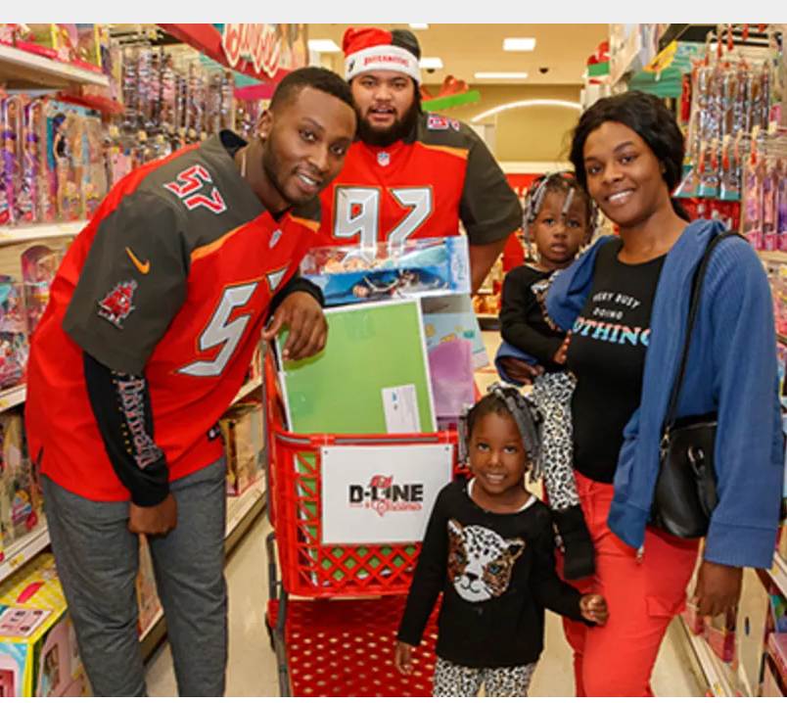


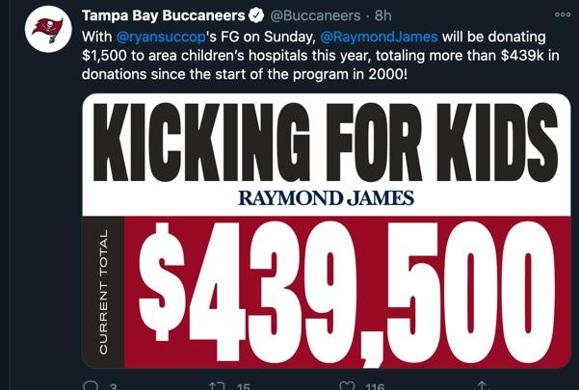
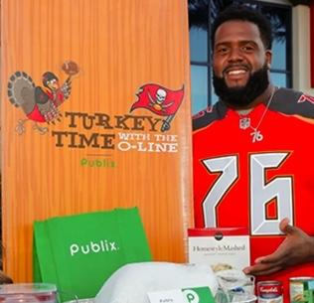
Community Outreach Examples
Bucs Community Foundation
The Bucs foundation works with youth in the community with outreach programs to inspire and enable youth. One example is the Junior Bucs fitness program sponsored by the foundation.
https://www.buccaneers.com/community/tampa-bay-buccaneers-foundation
Social Justice Initiatives
In 2018 the Tampa Bay Buccaneers Social Justice Initiative began with the purpose to “break down barriers to racial and social equality.” The initiative is centered on criminal justice reform, youth development, relations with police and overall social justice. It wants to be a positive influence in the community. The Bucs established a social justice player board. They engage in social causes in the local area and NFL.
https://www.buccaneers.com/community/social-justice
Kicking for Kids
For every field goal made, the initiative supports local children’s hospitals
https://www.buccaneers.com/video/kicking-for-kids-program-helps-save-children-s-lives-20318313
Glazer Vision Foundation
This foundation benefits children in need in the community by funding eye screenings and prescription glasses for those who need them.
https://www.glazervisionfoundation.org/
Player Initiatives
Thanksgiving Meals, Shopping for Christmas gifts, Military outreach
https://www.buccaneers.com/community/player-programs
Notes:
The Bucs do a great job reaching out to the community. These are just a few of many, many initiatives that the Bucs do on a regular basis. Even during the pandemic they managed to continue many community outreach programs including the Social Justice initiative as well as the work done through the Bucs and Glazer Foundations. In addition, individual players reached out directly for holiday initiatives for Thanksgiving and Christmas, and military outreaches.

Slide 10

Tampa Bay Bucs
Website
Positives
Good Organization
  Separate tabs for News, Team, Schedule, Video, Photos, Stadium, Social Justice
  Team site has a menu bar at the top with all of the main tabs and each tab has various subtabs. Team headlines, videos and photos are on the side and the most recent matchup recap at the center.
Eye-catching Design
Media Assets over 500 pages logically indexed
Useful Information for game day, game previews, the stadium, purchasing tickets etc.
Team and Player Stats easily accessed
Negatives
Could make site more interactive through surveys or polls, contests or other vehicles that require response
Lacks 3D stadium map
Overall very positive site
Comparison to other sites
Bucs are lacking a 3D map of the stadium which makes it much easier for the viewer to get an accurate depiction of the view they will have before purchasing the seats.
Bucs site is very engaging does not lack any key items
Compared to the Falcons, Panthers and Saints, the Bucs site is excellent
  The other sites are all lacking some items that are on the Bucs sites such as an easily accessible media guide with all the information that the Bucs provide,
  All the sites have similar format and software used
Notes:
The Bucs website is really top notch. It is engaging, eye-catching and full of key information. I could only find one missing item when comparing to other teams, and that was a 3D map of the stadium. Overall, the site is easy to use and has what is needed for both fans and media to access.

Slide 11
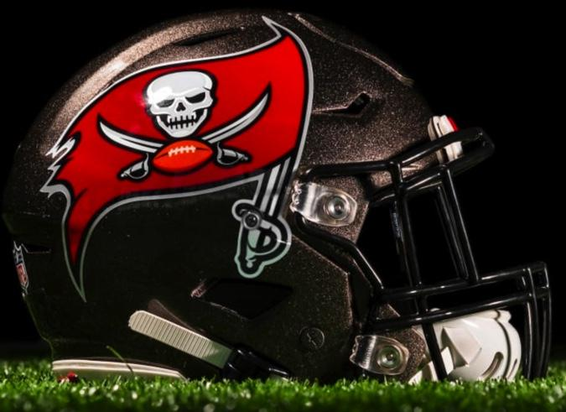
Effectiveness of
Communications Operations
Are they meeting their goals in 2020?
Growth of Social Media
Growth of Merchandising revenue
Growth of Sponsorships
Signing of top talent players
Positive publicity
Increased fan interaction
Growth of Ticketing revenue
Suggestions on how they could meet their goals more effectively (post-pandemic)
More ticket promotions to kickstart after pandemic
More in-person events
More sponsorship tie-in’s at games
Publicize ongoing health and safety measures even after pandemic
More visibility of star players
Notes:
There is no question that 2020 was a banner year for the Bucs even with the pandemic. The signings of Tom Brady, Rob Gronkowski and Antonio Brown made sure of that. The Tom Brady Bucs jersey was the best selling jersey in the country when his signing was announced, so merchandising sales grew exponentially. Sponsorships mushroomed and publicity was through the roof. Social media followers increased. Unfortunately the performance of the team has been mixed. The pandemic stopped the Bucs from selling out the stadium as they surely would have without the pandemic. Once the pandemic is behind us, my only suggestions would be to build on what they have already done and fuel ticket sales growth through more in person events, promotions, sponsor tie-in’s and by increasing the participation of our star players to grow even further. In addition, even when the pandemic is over, the Bucs should continue to publicize appropriate health and safety protocols at the stadium and all in-person events.
I hope you enjoyed my presentation and go Bucs!

